Slide 1



EML 4551C SENIOR DESIGN
DR. KAMAL AMIN
TEAM 4: ALTERATE MATERIAL SELECTION FOR COMPRESSOR CASING IN TURBOCHARGER
DESIGN REVIEW PRESENTATION #2
Group Members alexander Mankin
HARRISON MCLARTY
Ralph Scott
Abiodun OLUWALOWO
Project sponsor AND FACULTY Adviser
Cummins - Roger England
DR. PETER KALU
18 MARCH 2014

Slide 2
Outline
Project Scope
Project Background
Project Objectives
Fall Accomplishments
Design Concepts
Design Analysis
Potential Challenges and Risks
Status of Procurement
Future Work
Final Summary
References
Questions

Slide 3
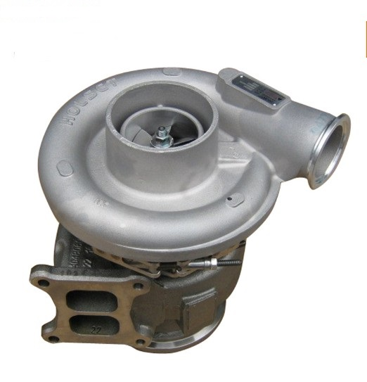
Project Scope
Cummins has an interest in researching and selecting alternate materials to fabricate compressor casings in their B series turbochargers
This alternate material should ultimately be more cost effective than the current one in use, cast aluminum 356, and still satisfy the design and operational parameters set by Cummins
Fig.1: View of turbocharger compressor casing.[5]
Estimates of manufacturing costs for this alternate material and verification of burst containment are essential
Harrison McLarty

Slide 4
Project Background
In industry more cost efficient materials are always being researched
Finding new materials which could replace cast aluminum 356 presents many beneficial opportunities for Cummins
The revenue gained from more cost efficient materials and manufacturing processes present financial advantages for Cummins
Production numbers on compressor casings and turbochargers have the potential to grow allowing the company to meet and exceed the expectations of customers
Harrison McLarty

Slide 5
Project Objectives
Determine the temperatures, pressures, and stresses experienced by the compressor during operation
Research and compare materials which can operate under these prescribed physical conditions, and are cheaper both as a material and to manufacture
Estimate manufacturing costs with this new material and compare it to cast aluminum 356, which is currently used to fabricate the casings
With the known operational conditions and alternate material known, utilize Finite Element Analysis in conjunction with a CAD model of the casing for analysis
Obtain three prototypes of these casings for testing and experimentation
Harrison McLarty

Slide 6
Fall 2013 Accomplishments
PEEK(Polyether ether ketone) was selected as the material to be used as the compressor casing after thorough research.
FEA analysis was conducted on a cross section of the casing’s piping to ensure that the material selected would not deform significantly during operation.
A contact at Cummins was found who will obtain prototypes based on our chosen alternate material.
Initial research was begun on carrying out FEA analysis for the burst event.
Harrison McLarty

Slide 7
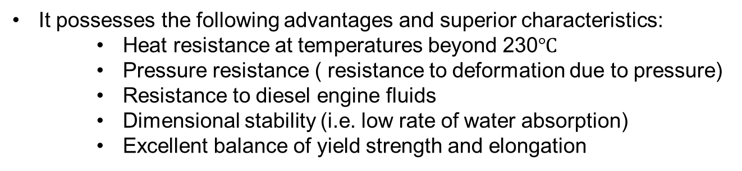
Design Concepts: Material for prototype
With the aid of a weighted decision matrix PEEK (unfilled) was found to be the most effective material for fabricating a compressor casing
It possesses the following advantages and superior characteristics:
    Heat resistance at temperatures beyond 230$℃$
    Pressure resistance ( resistance to deformation due to pressure)
    Resistance to diesel engine fluids
    Dimensional stability (i.e. low rate of water absorption)
    Excellent balance of yield strength and elongation
Harrison McLarty

Slide 8
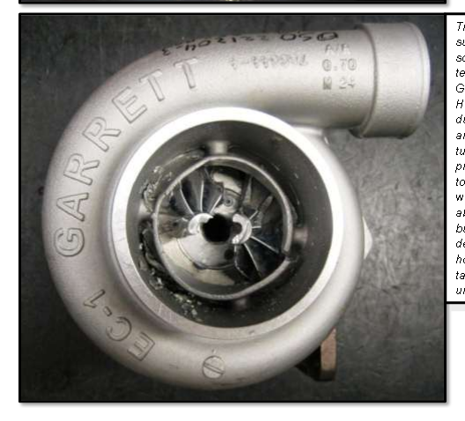
Design Concepts: Need for burst analysis
“Burst” occurs when the centrifugal force undergone by impeller wheels, due to their rotational speed, overcome the mechanical strength of the wheel.
Causes of a burst event include:
  Reduction of strength due to high internal stresses associated with high temperatures and speeds
  Fatigue failure due to cyclic loading (i.e. stop and go motion of a city bus)
  Foreign object damage (FOD) (i.e. a rock or piece of rubber impacting a wheel)
Fig.2 Example of a burst containment test. [5]
Although a rare event, this must be kept in mind when selecting materials for either the compressor or turbine housing due to the safety concern of burst.
Materials with the proper yield strength, % elongation (ductility), and maximum operational temperature must be considered to withstand this event.
Harrison McLarty

Slide 9
Design Concepts
Injection Molding Cost Analysis
Mold Costs
The cost of a mold can vary greatly based on complexity, quality, and size.
Simple, single cavity mold: $2,000-3,000
High production, multi-cavity mold: $60,000-100,000
Addition Injection molding Costs
To gain knowledge on creating a more accurate injection molding cost Analysis, we plan to speak to Dr. Chengying Xu who will hopefully guide us in the right direction to preform proper cost analysis.
Unfortunately Dr. Xu will not be available to meet with us until the week of the 25th of March.
Ralph Scott

Slide 10


Design Concepts
Injection Molding Cost Estimation Equations
The following are equations that can be used to determine manufacturing cost associated with producing a injection molded part.
1.)
2.)
Ralph Scott

Slide 11
Design Concepts
Injection Molding Cost Estimation Equations
The cost drivers of manufacturing injection molded parts are expressed in Equation 1.
1.)
Ralph Scott

Slide 12
Design Concepts
Injection Molding Cost Estimation Equations
Equation 2 is an expression for the assembled product cost
2.)
Ralph Scott

Slide 13
Design Concepts
To further validate the safety of the casing, simulation of a burst event was performed
It was performed in Comsol and used the following criteria
Failure Analysis was performed for two different compressor wheel speeds, 90,000 and 120,000 rpm
Due to their design, compressor wheels usually fail by breaking into 2 or 3 pieces
Impact speed was found using the relationship between rotational kinetic energy and kinetic energy of a rigid body
Force was found by using the classic force formula
Alex Mankin

Slide 14
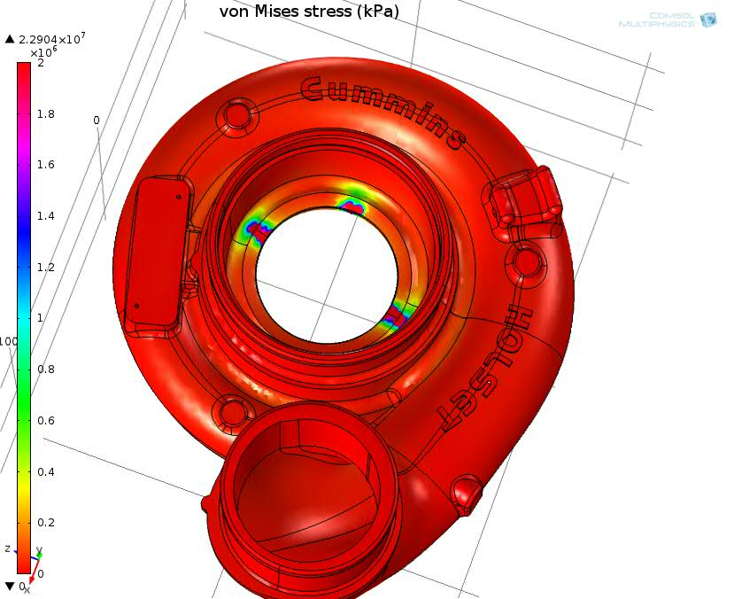
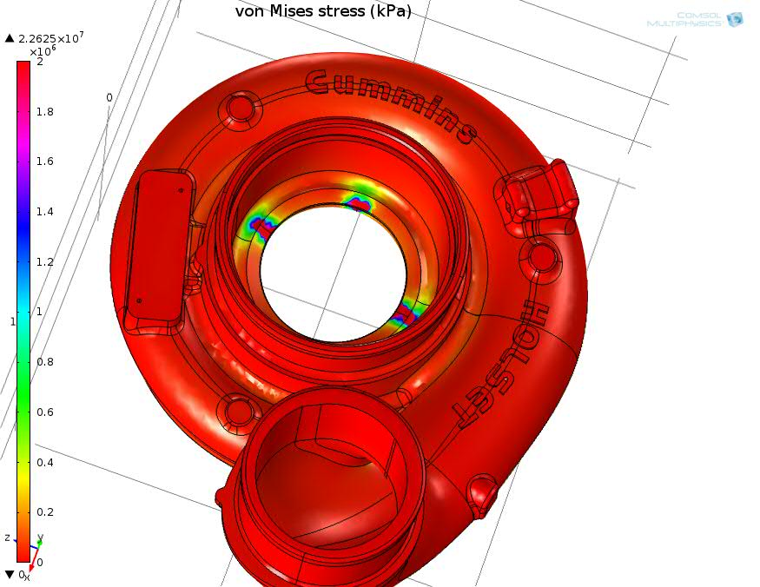
Burst Containment Analysis 90,000 rpm
Fig. 3 PEEK von Mises Stress
Fig.4 Cast Aluminum 356 von Mises stress
Alex Mankin

Slide 15
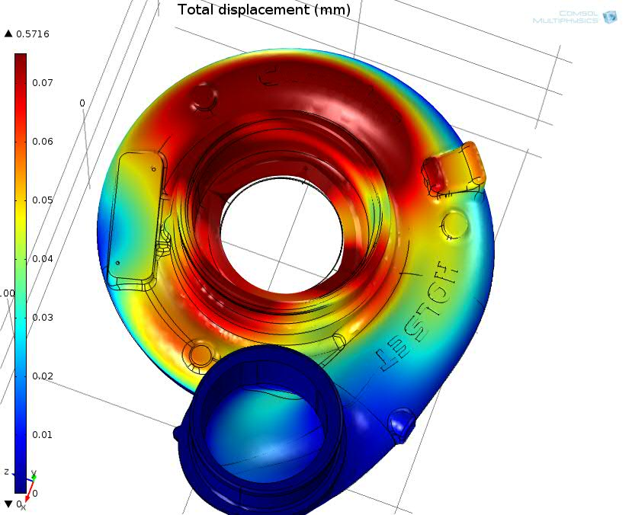
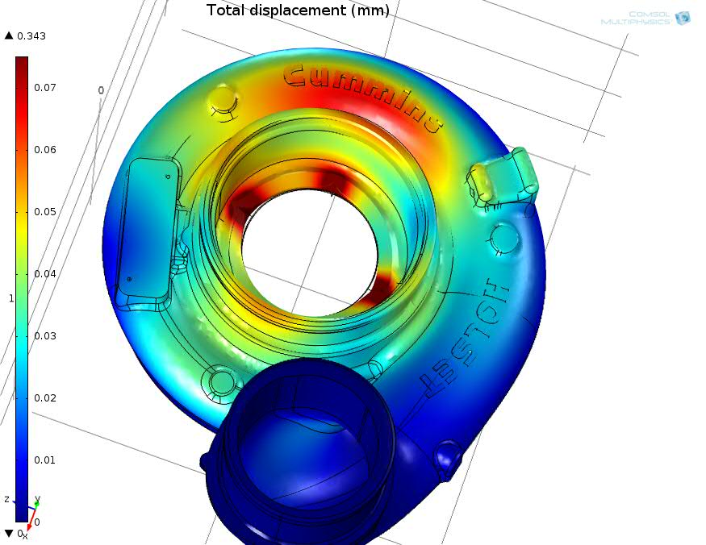
Burst Containment Analysis 90,000 rpm
Fig. 5 PEEK Total Displacement
Fig.6 Cast Aluminum 356 Total Displacement
Alex Mankin

Slide 16
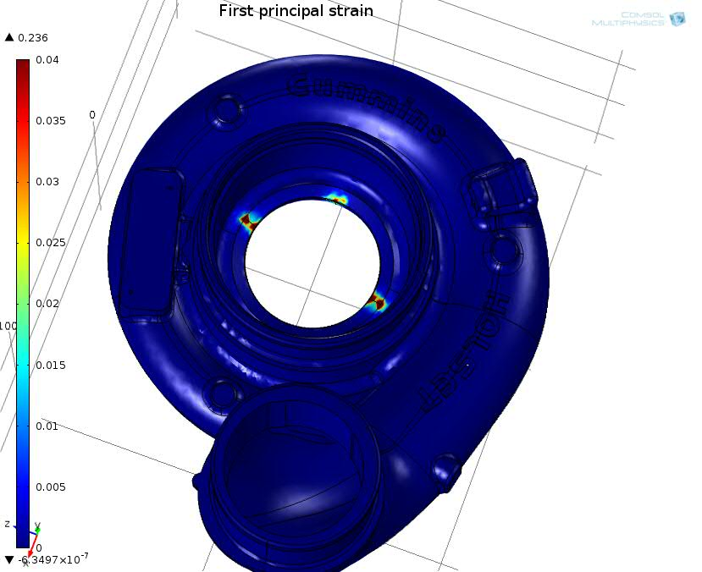
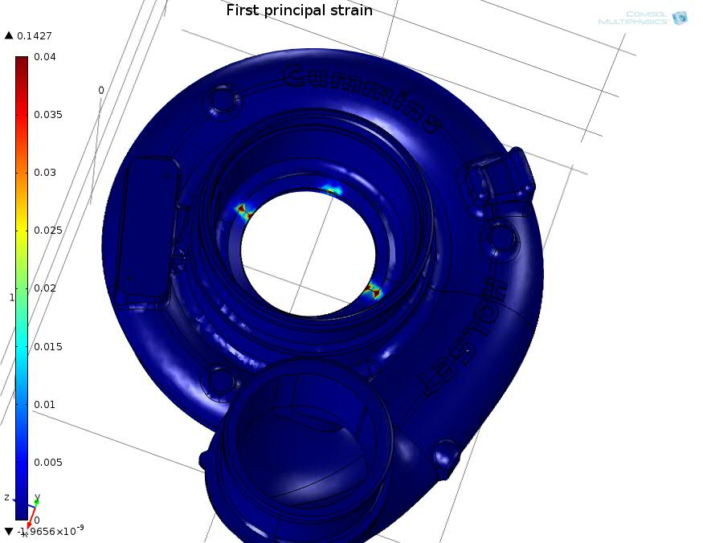
Burst Containment Analysis 90,000 rpm
Fig. 7 PEEK 1st Principle Strain
Fig.8 Cast Aluminum 356 1st Principle Strain
Alex Mankin

Slide 17
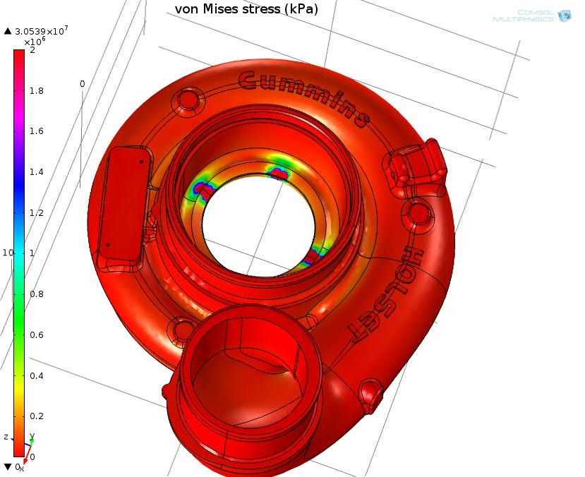
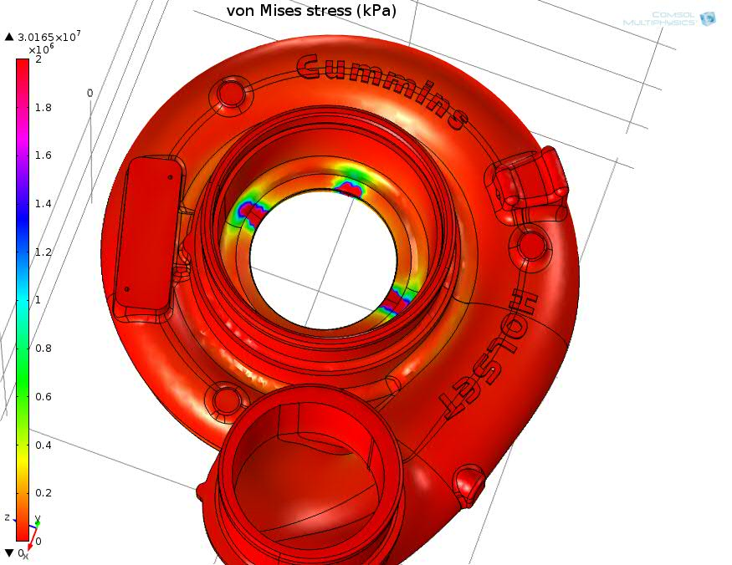
Burst Containment Analysis 120,000 rpm
Fig. 9 PEEK von Mises Stress
Fig.10 Cast Aluminum 356 von Mises stress
Alex Mankin

Slide 18
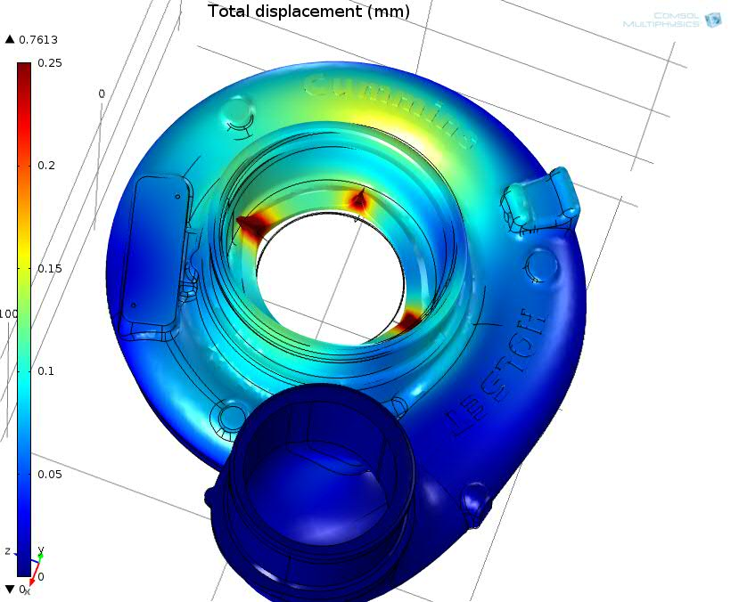
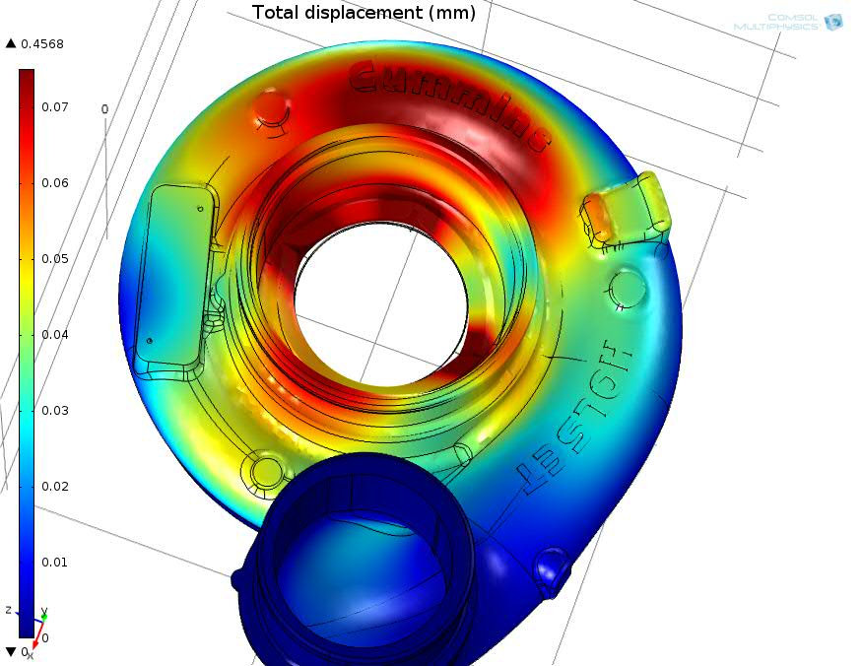
Burst Containment Analysis 120,000 rpm
Fig. 11 PEEK Total Displacement
Fig.12 Cast Aluminum 356 Total Displacement
Alex Mankin

Slide 19
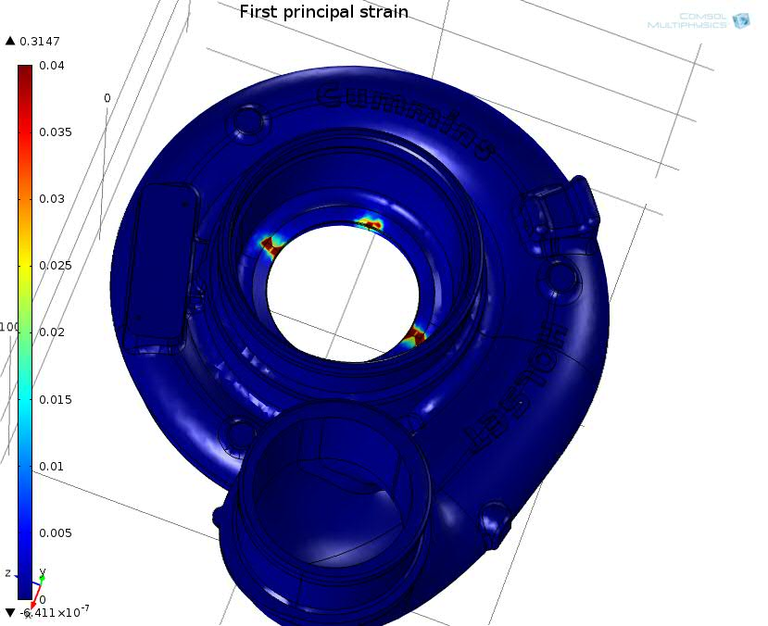
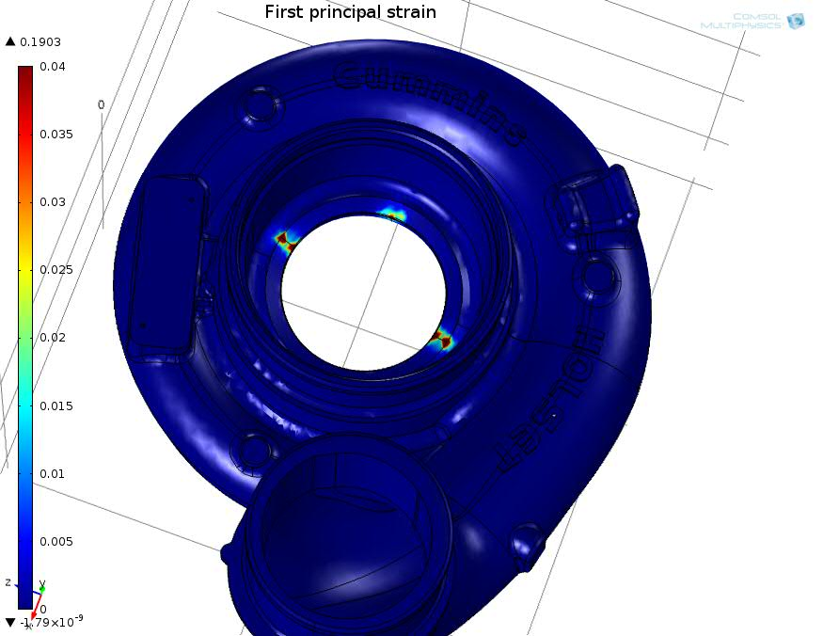
Burst Containment Analysis 120,000 rpm
Fig. 13 PEEK 1st Principle Strain
Fig.14 Cast Aluminum 356 1st Principle Strain
Alex Mankin

Slide 20
Burst Containment Analysis Summary
The analysis shows that PEEK deforms a higher amount relative to the cast aluminum which is currently used
This deformation occurs the most at the location of impact with smaller deformation occurring in the surrounding material
It also shows that despite this higher amount of deformation the casing still absorbs the burst event adequately and without a catastrophic failure of the material
This result of the burst containment analysis shows that the PEEK material is a valid and safe selection for use as an alternative material
The validity of this analysis could be tested if a real burst test was performed with the PEEK material
Alex Mankin

Slide 21
Potential Challenges and Risks
Making sure the assumptions and cost estimations made during the manufacturing cost analysis are accurate, and comparable to real world applications.
Ensuring that our analysis on our 3-D model of the compressor casing, is an accurate representation of the effects the compressor casing would undergo in the field.
Ralph Scott

Slide 22
Status of procurement
The prototype based on PEEK could not be machined because it could not be procured in a large enough block.
A proprietary powder material was instead used to 3-D print a compressor casing prototype for demonstration purposes only.
Ralph Scott

Slide 23
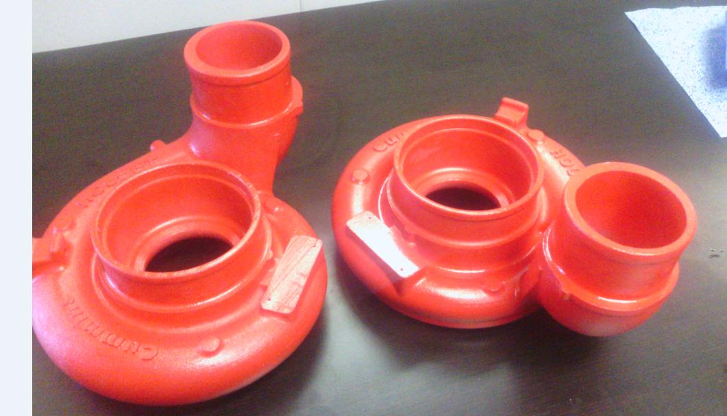
Status of procurement
Fig.15 3D Printed Compressor Casing
Ralph Scott

Slide 24
Future Work Plans
The future plans includes the following:
Calculating and estimating the manufacturing costs using the equations and parameters that was given in the previous slides
Also in order to have accurate cost evaluations some faculty members will be consulted (Dr. Chengying Xu )
Ralph Scott

Slide 25
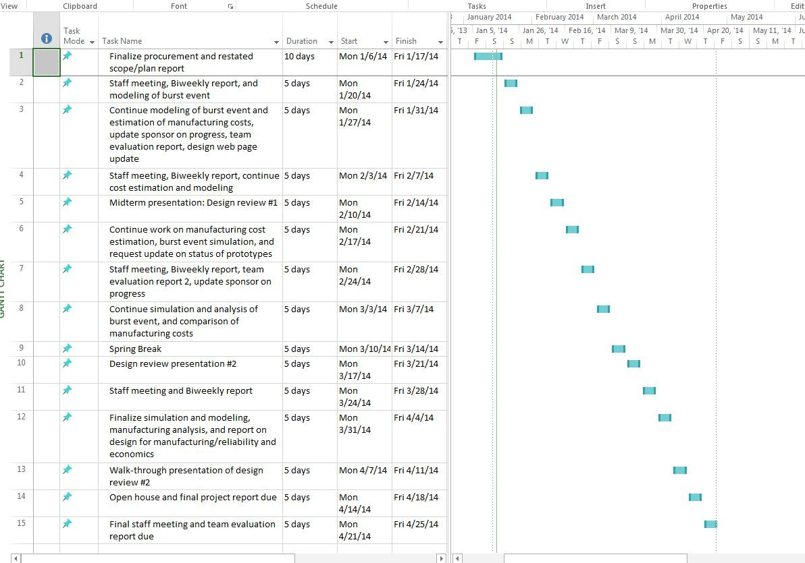
Gantt Chart
Ralph Scott

Slide 26
Conclusions
A burst analysis was completed which showed that PEEK was an adequate replacement for the current material used.
We will continue to refine our manufacturing cost analysis.
We also now have a 3-D printed full scale model of our turbocharger compressor casing for display purposes only
Ralph Scott

Slide 27
References
1. "Turbo Torque." Turbo Torque. N.p., n.d. Web. 21 Oct. 2013. <http://www.mazdarotary.net/turbo.htm>.
2. "Online Materials Information Resource - MatWeb." Online Materials Information Resource - MatWeb. N.p., n.d. Web. 21 Oct. 2013. <http://www.matweb.com/>.
3. "Plastic Sheet, Plastic Rod, Plastic Tubing - Buy Online." Plastic Sheet, Plastic Rod, Plastic Tubing - Buy Online. N.p., n.d. Web. 21 Oct. 2013. <http://www.professionalplastics.com/>.
4. "VICTREX® PEEK Polymers." High Performance Polyaryletherketones, High Temperature Advanced PEEK Polymer, Thermoplastic. N.p., n.d. Web. 19 Nov. 2013. <http://www.victrex.com/en/products/victrex-peek-polymers/victrex-peek-polymers.php>.
5. "Burst and Containment: Ensuring Turbocharger Safety." Turbobygarrett.com. N.p., n.d. Web. 19 Nov. 2013. <http://www.turbobygarrett.com/turbobygarrett/sites/default/files/Garrett_White_Paper_02_Burst__Containment.pdf>.
6. Fagade, Adekunle A., and David O. Kazmer. "EARLY COST ESTIMATION FOR INJECTION MOLDED PARTS." University of Massachusetts Amherst (n.d.): n. pag. Web.

Slide 28
Questions

